Slide 1
Data Visualization

Slide 2
What is Data Visualization?
Data visualization is the graphical representation of information and data. By using visual elements like charts, graphs, and maps, data visualization tools provide an accessible way to see and understand trends, outliers, and patterns in data.
In the world of Big Data, data visualization tools and technologies are essential to analyze massive amounts of information and make data-driven decisions.

Slide 3
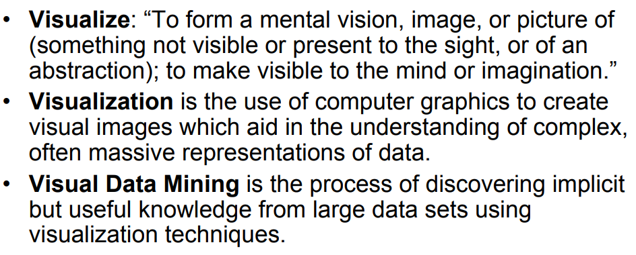
What is Visualization and Data Mining?

Slide 4
The benefits of Data Visualization
Our eyes are drawn to colors and patterns. We can quickly identify red from blue, square from circle. Our culture is visual, including everything from art and advertisements to TV and movies.
Data visualization is another form of visual art that grabs our interest and keeps our eyes on the message. When we see a chart, we quickly see trends and outliers. If we can see something, we internalize it quickly. It’s storytelling with a purpose. If you’ve ever stared at a massive spreadsheet of data and couldn’t see a trend, you know how much more effective a visualization can be.

Slide 5
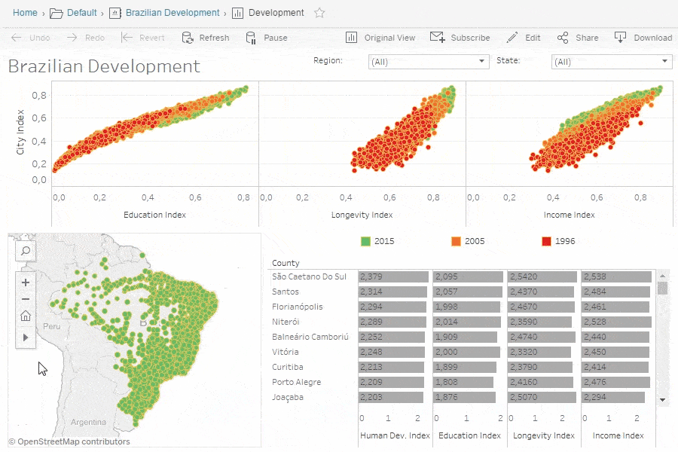
Cont’d…

Slide 6
The different types of visualizations
When you think of data visualization, your first thought probably immediately goes to simple bar graphs or pie charts. While these may be an integral part of visualizing data and a common baseline for many data graphics, the right visualization must be paired with the right set of information. Simple graphs are only the tip of the iceberg. There’s a whole selection of visualization methods to present data in effective and interesting ways.

Slide 7
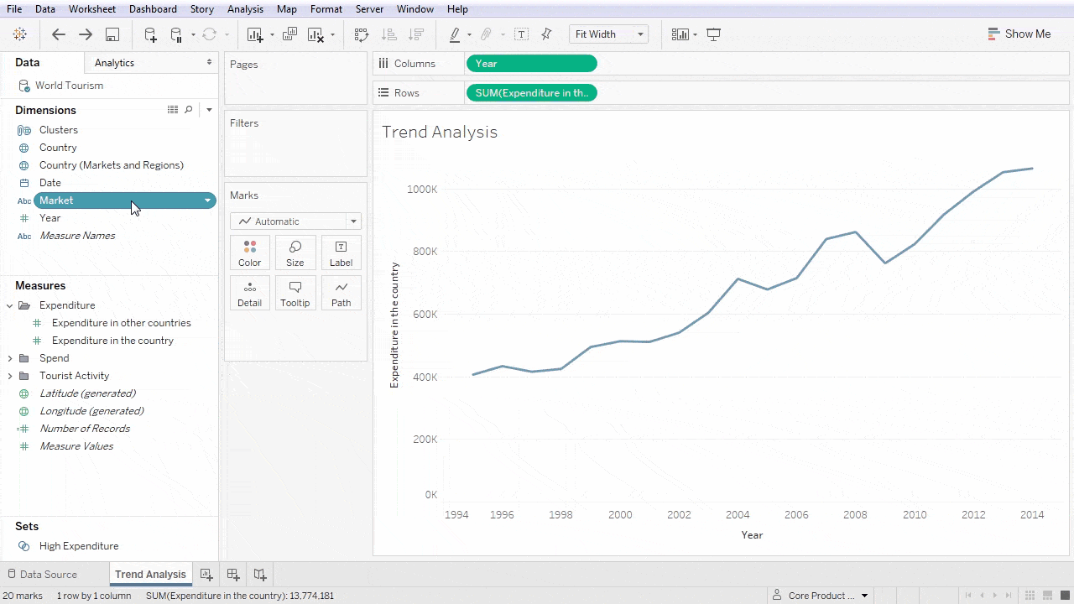
Common types of data visualization
Charts
Tables
Graphs
Maps
Infographics
Dashboards

Slide 8
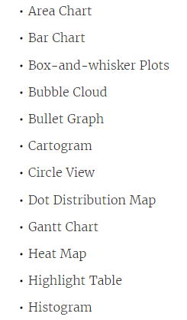
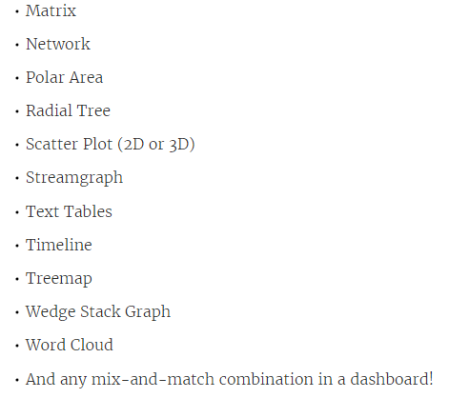
More specific examples of methods to visualize data

Slide 9
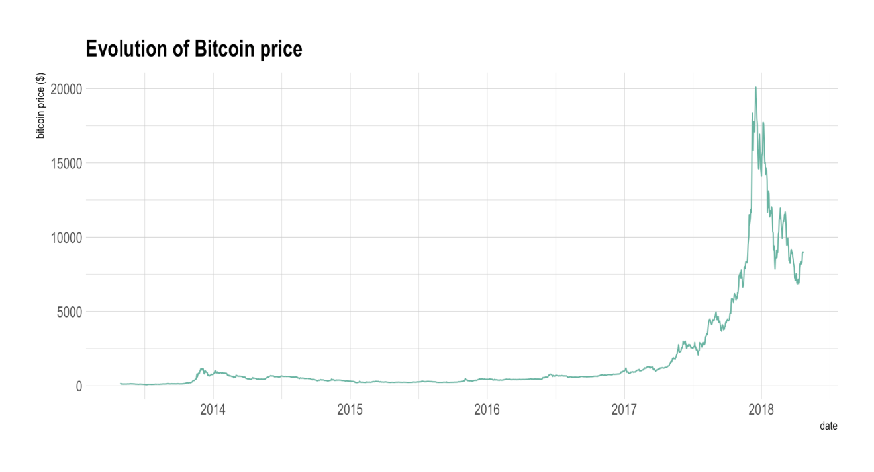
Line Chart
A line chart or line graph displays the evolution of one or several numeric variables. Data points are connected by straight line segments. It is similar to a scatter plot except that the measurement points are ordered (typically by their x-axis value) and joined with straight line segments. A line chart is often used to visualize a trend in data over intervals of time – a time series – thus the line is often drawn chronologically.
The following example shows the evolution of the bitcoin price between April 2013 and April 2018.

Slide 10
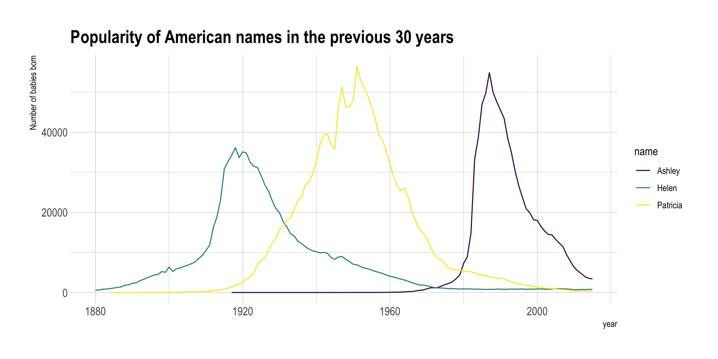
Cont’d…
Line chart can be used to show the evolution of one (like above) or several variables. Here is an example showing the evolution of three baby name frequencies in the US between 1880 and 2015. Note that this works well for a low number of group to display. With more than a few, the graphic get cluttered and becomes unreadable. This is called a spaghetti chart.

Slide 11
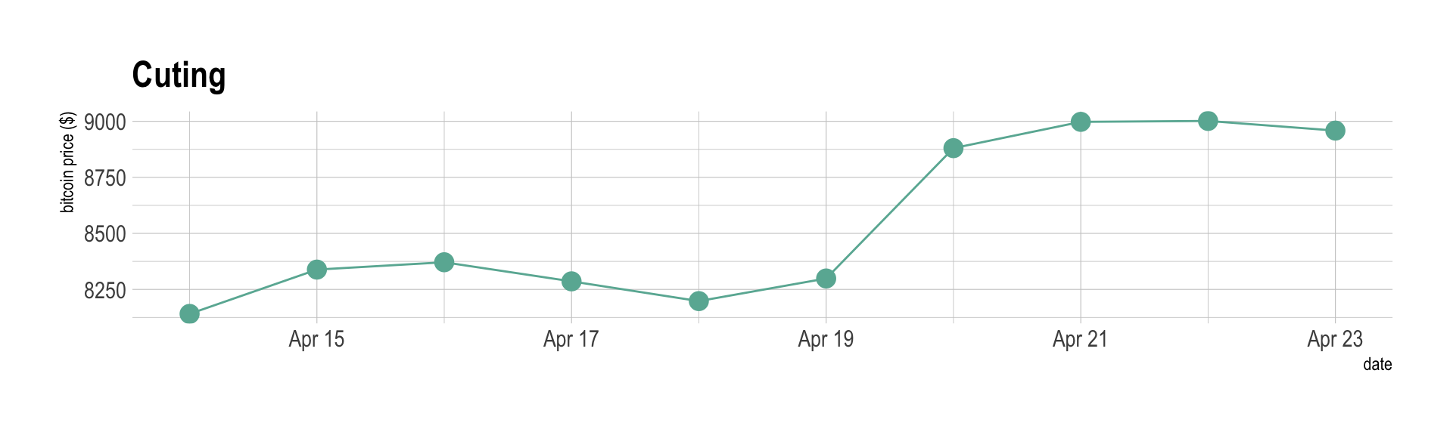
Variation
If the number of data points is low, it is advised to represent each individual observation with a dot. It allows to understand when exactly the observation have been made:

Slide 12
When to Use a Line Chart
If seeing the trend of your data is the goal, then this is the chart to use. Line charts show time-series relationships using continuous data (that which is measured and has a value within a range). They allow a quick assessment of acceleration (lines curving upward), deceleration (lines curving downward), and volatility (up/down frequency). They are excellent for tracking multiple data sets on the same chart to see any correlation in trends.

Slide 13
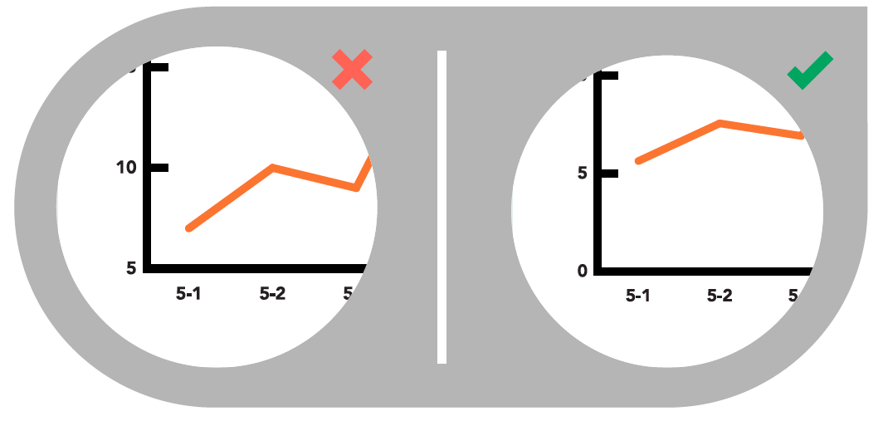
Common caveats
Include a Zero Baseline if Possible
Although a line chart does not have to start at a zero baseline, it should be included if possible. If relatively small fluctuations in data are meaningful (e.g., stock market data), you may truncate the scale to showcase these variances.

Slide 14
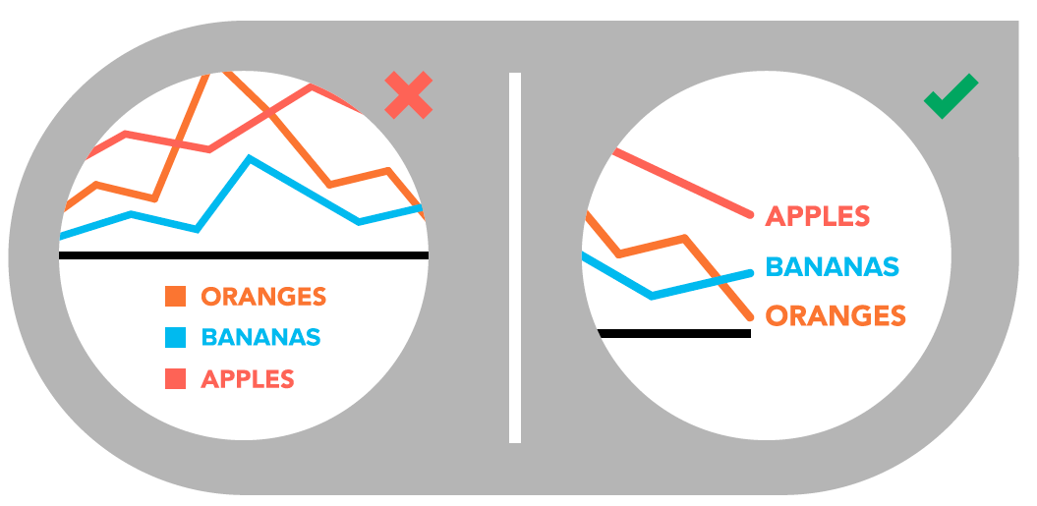
Cont’d…
Label Lines Directly
This lets readers quickly identify lines and corresponding labels instead of referencing a legend.

Slide 15
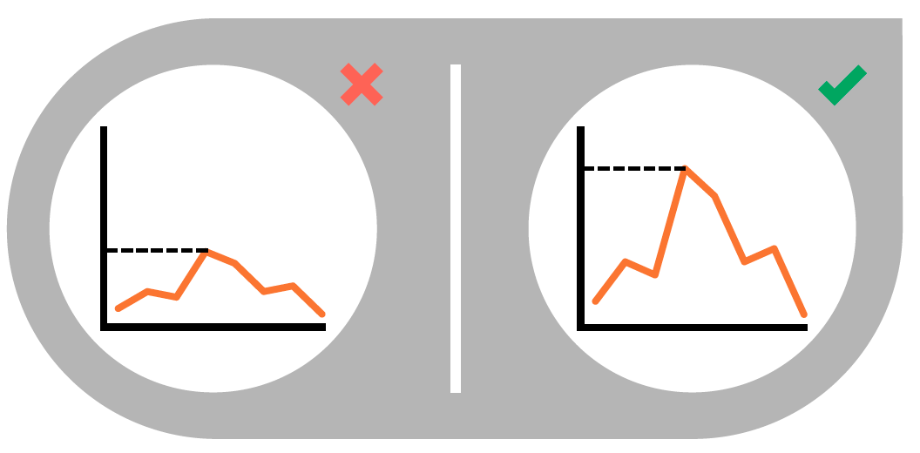
Cont’d…
Use the Right Height
If you need to compare the evolution of 2 different variables, do not use dual axis. Indeed dual axis can show very different results depending on what range you apply to the axis.
Mind the spaghetti chart: too many lines make the chart unreadable.
Think about the aspect ratio of the graphic, extreme ratio make the chart unreadable.

Slide 16
Pie Chart
Pie charts are one of the oldest and most popular ways to visualize data. This classic chart is the perfect example of the power of data visualization: a simple, easy-to-understand presentation that helps readers instantly identify the parts of a whole.
The typical pie chart is divided into sections that illustrate a numerical proportion. Each section expresses its quantity through the size of the central angle in proportion to the others. What makes this visually powerful is that the central angle, the outside arc length, and the area these define all proportionally correspond to the quantity they represent.

Slide 17

Cont’d…

Slide 18
When to Use a Pie Chart
Pie charts are best used when making part-to-whole comparisons (for example, the number of red cars produced each year compared to other popular colors). The message that we are observing fractions of a whole amount is built right into their design—something that can’t be said for most other chart types. They have the most impact when the proportion being expressed holds more importance than the specific numbers. They are most clearly understood when using small data sets, often grouping smaller data into an “other” category on the chart.

Slide 19
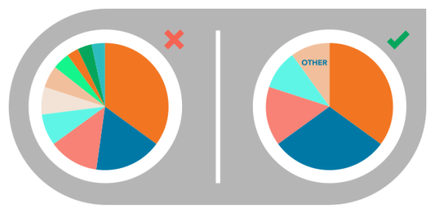
Tips for Creating Pie Charts
Visualize no more than 5 categories per chart
It is difficult to differentiate between small values; depicting too many slices decreases the impact of the visualization. If needed, you can group smaller values into an “other” or “miscellaneous” category, but make sure it does not hide interesting or significant information.

Slide 20

Cont’d…
Don’t use multiple pie charts for comparison
Slice sizes are very difficult to compare side-by-side. Use a stacked bar chart instead.

Slide 21
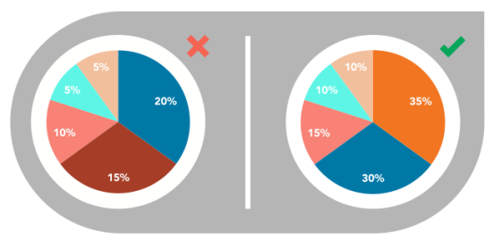
Cont’d…
Make sure all data adds up to 100%
Verify that values total 100% and that pie slices are sized proportionately to their corresponding value.

Slide 22
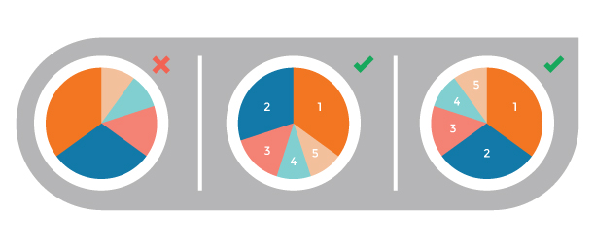
Cont’d…
Order slices correctly
There are two ways to order sections, both of which are meant to aid comprehension:
Option 1: Place the largest section at 12 o’clock, going clockwise. Place remaining sections in descending order, going clockwise.
Option 2: Place the largest section at 12 o’clock, going counterclockwise. The remaining sections can be placed below, continuing counterclockwise.

Slide 23
Bar Chart
Bar charts are a highly versatile way to visually communicate data. Decidedly straightforward, they can convey the message behind the numbers with impact and meaningful clarity, making complex data easy to understand at a glance.
The bar chart is a chart with rectangular columns proportional in length to the values they represent. Simply put, longer bars equal bigger numbers. On one axis these bars compare categories, while on the other they represent a discrete value.

Slide 24
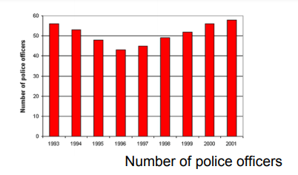
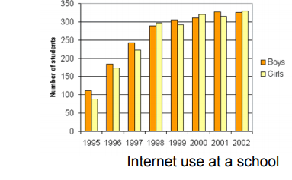
Example

Slide 25
When to Use
Bar charts are used to showcase discrete data—the data that is based on counts and can only be certain values. They are most effectively to:
Show change over time (e.g., the net monthly earnings of Tesla Motors in a year)
Compare values of different categories (e.g., a year’s fishing yields for different species of fish)
Compare parts of a whole (e.g., the percent distribution of Netflix rentals across genres)

Slide 26
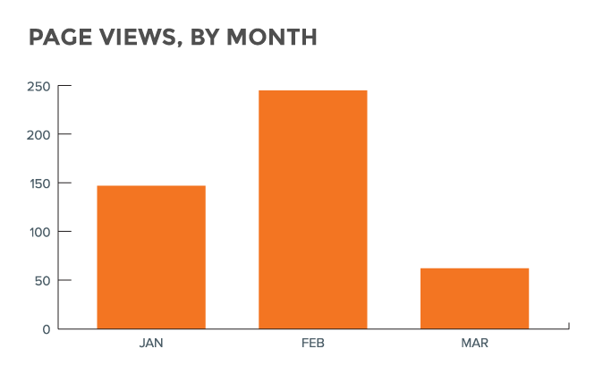
Variations
The standard bar chart can be used with bars aligned either vertically or horizontally. Vertical orientations are best used for chronological data or when negative values are involved.

Slide 27
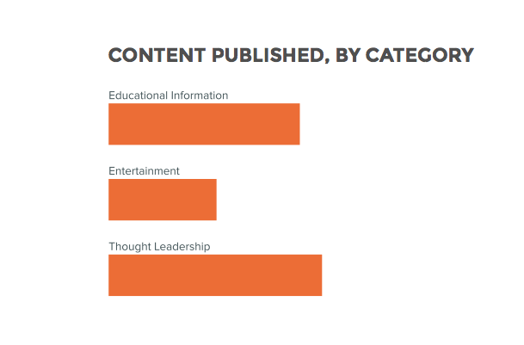
Cont’d…
Horizontal orientations are best used when charting different categories, especially with long labels.

Slide 28
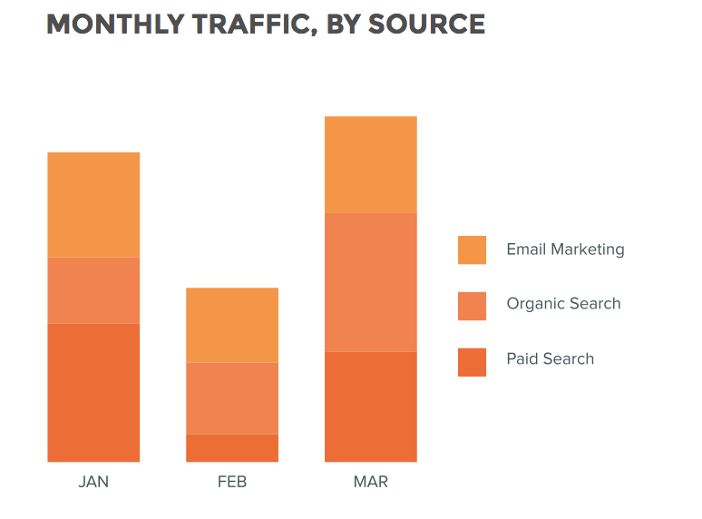
Cont’d…
Stacked bar charts allow you to showcase and compare part-to-whole relationships.

Slide 29
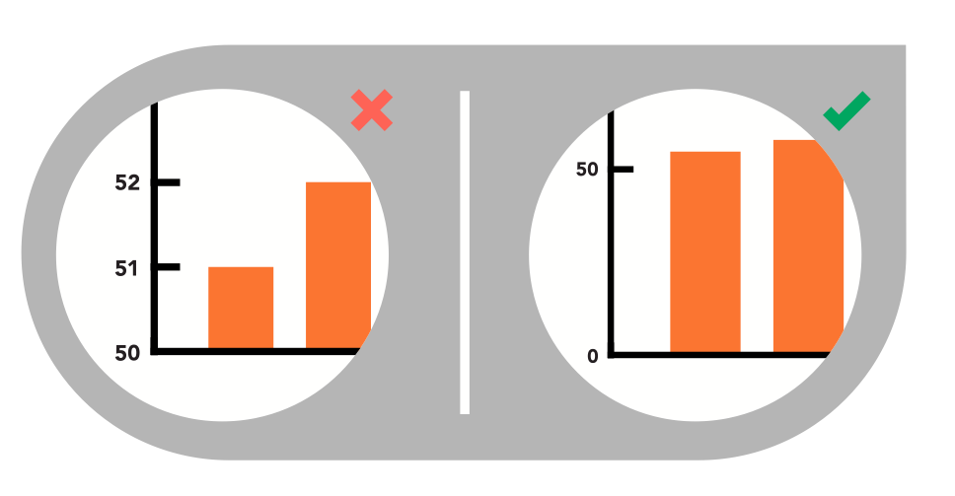
Best Practices for Designing Bar Charts
Start the Y-Axis at 0
Starting at a value above zero truncates the bars and doesn’t accurately reflect the full value

Slide 30
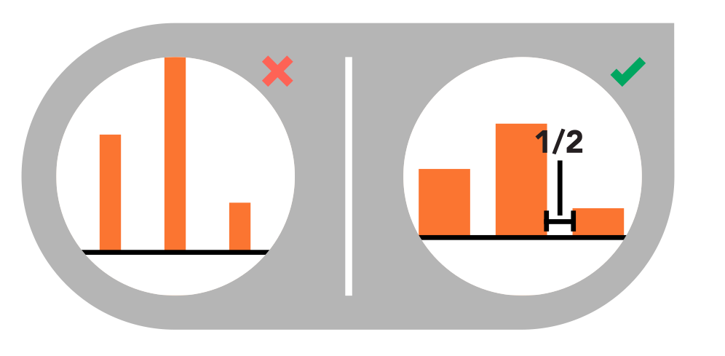
Cont’d…
Space bars appropriately
The space between bars should be roughly ½ bar width.

Slide 31
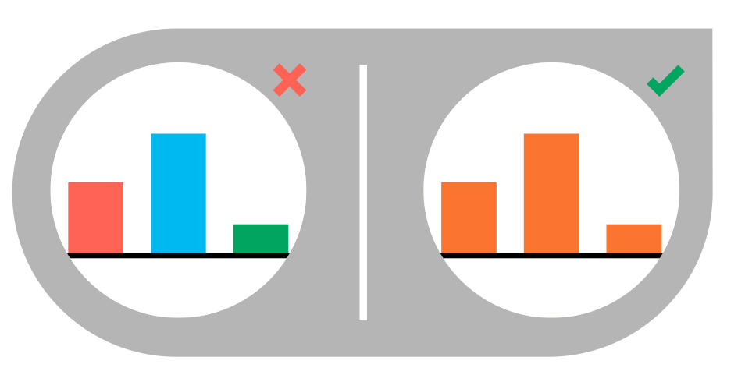
Cont’d…
Use consistent colors
Use one color for bar charts. You may use an accent color to highlight a significant data point.

Slide 32
Histogram
A histogram is an accurate graphical representation of the distribution of a numeric variable. It takes as input numeric variables only. The variable is cut into several bins, and the number of observation per bin is represented by the height of the bar.

Slide 33
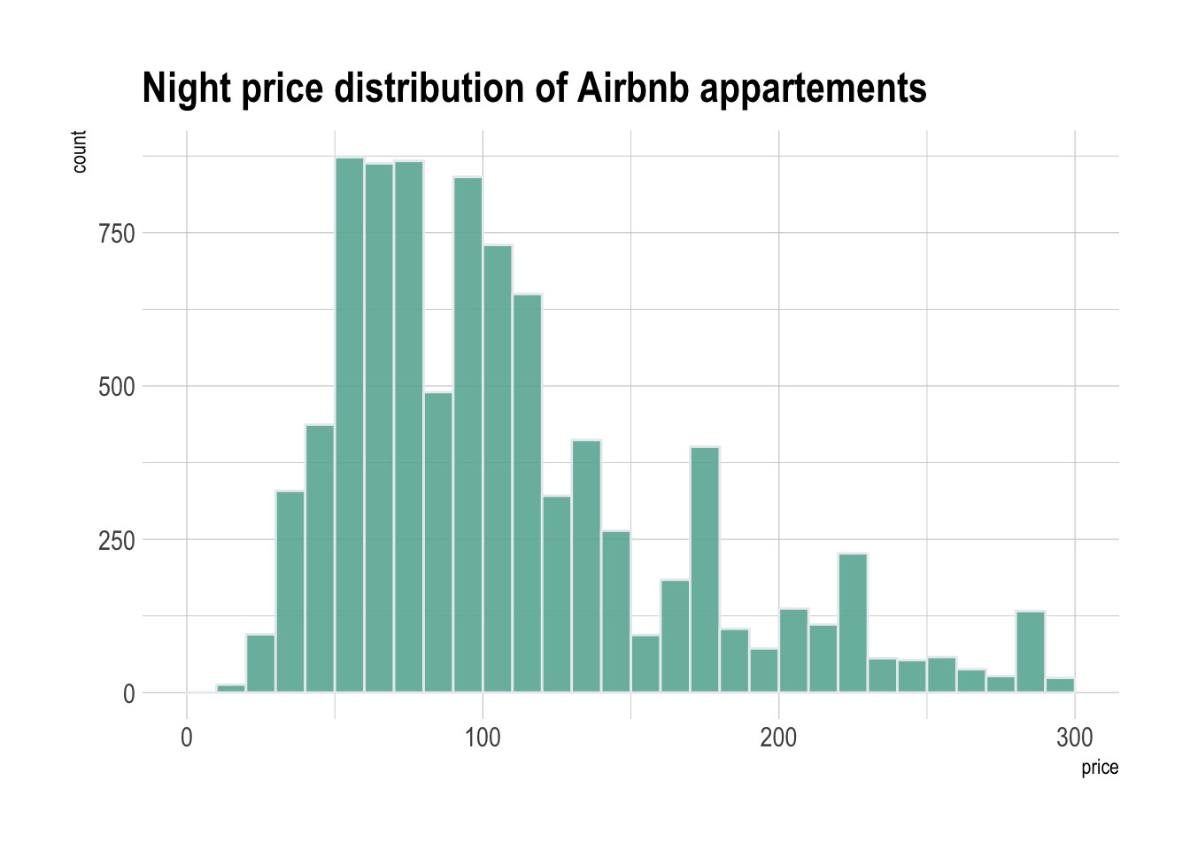
Example
Here is an example showing the distribution of the night price of Airbnb appartements in the south of France. Price range is divided per 10 euros interval. For example, there are slightly less than 750 appartements with a night price between 100 and 110 euros:

Slide 34
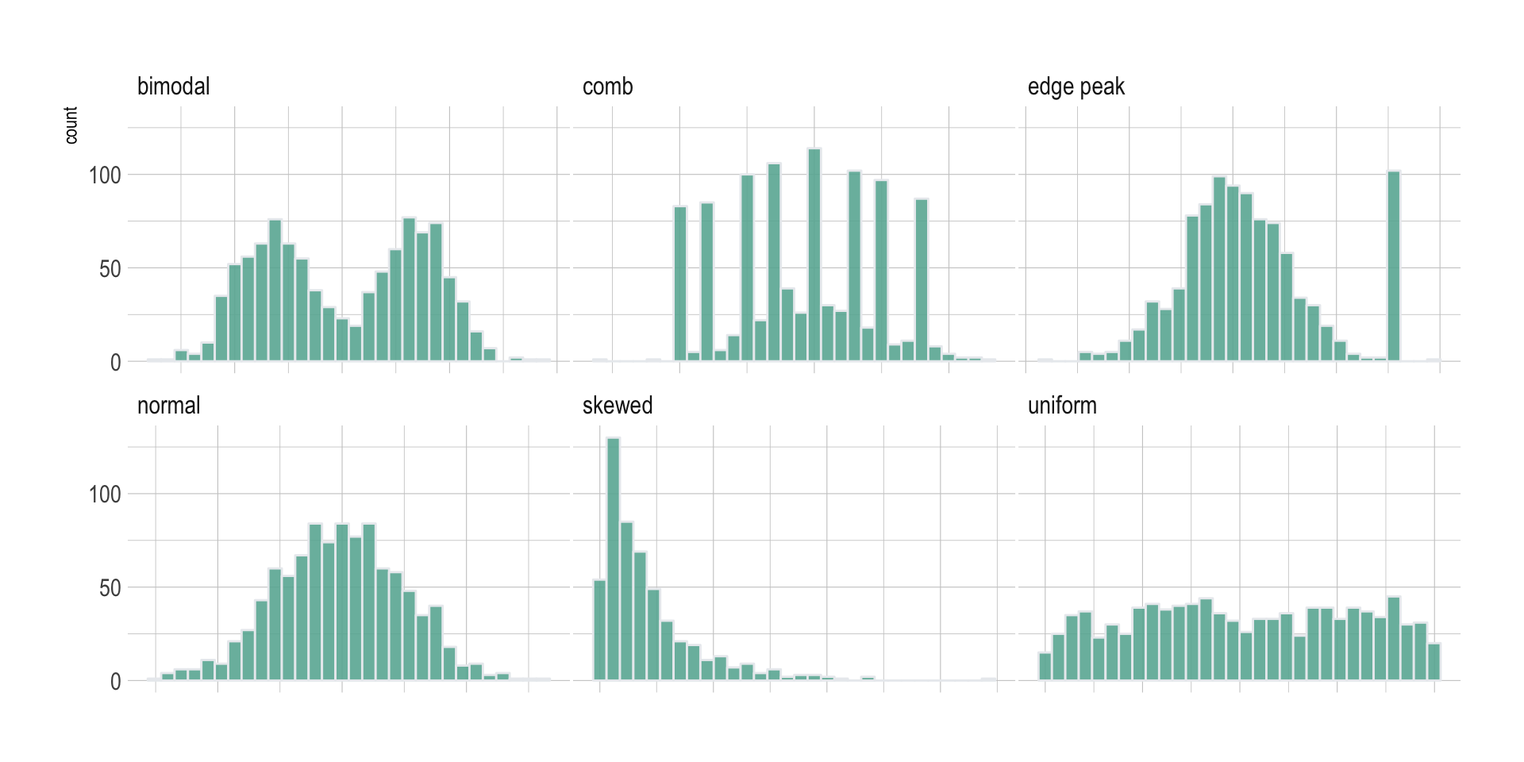
What for
Histogram are used to study the distribution of one or a few variables. Checking the distribution of your variables one by one is probably the first task you should do when you get a new dataset. It delivers a good quantity of information. Several distribution shapes exist, here is an illustration of the 6 most common ones:
Checking this distribution also helps you discovering mistakes in the data. For example, the comb distribution can often denote a rounding that has been applied to the variable or another mistake.

Slide 35
Multimodal Distribution
A multimodal distribution is a probability distribution with more than one peak, or “mode”.
A distribution with one peak is called unimodal.
A distribution with two peaks is called bimodal.
A distribution with two peaks or more is multimodal.

Slide 36

Cont’d…
A comb distribution is so-called because the distribution looks like a comb, with alternating high and low peaks. A comb shape can be caused by rounding off. For example, if you are measuring water height to the nearest 10 cm and your class width for the histogram is 5 cm, this could cause a comb shape.

Slide 37

Cont’d…
An edge peak distribution is where there is an additional, out of place peak at the edge of the distribution. This usually means that you’ve plotted (or collected) your data incorrectly, unless you know for sure your data set has an expected set of outliers (i.e. a few extreme views on a survey).

Slide 38

Cont’d…
A multimodal distribution is known as a Plateau Distribution when there are more than a few peaks close together.

Slide 39
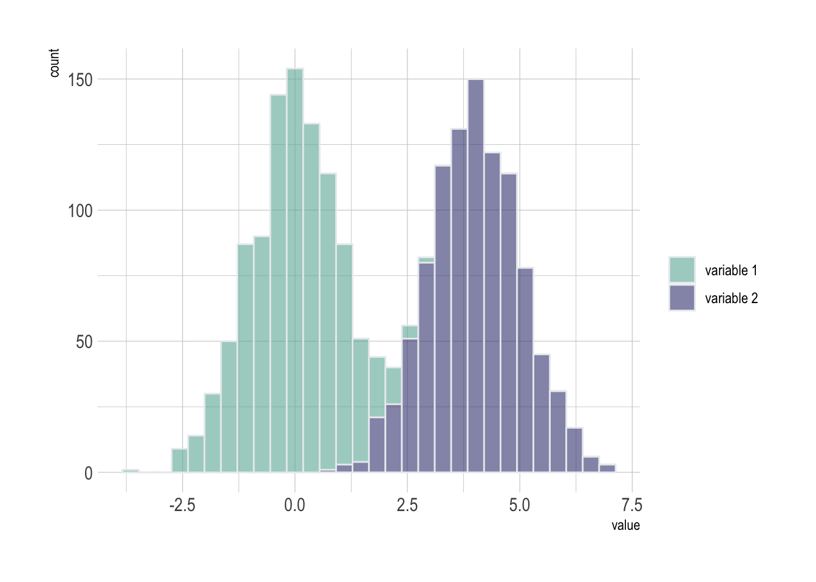
What for
As a second step, histogram allow to compare the distribution of a few variables. Don’t compare more than 3 or 4, it would make the figure cluttered and unreadable. This comparison can be done showing the 2 variables on the same graphic and using transparency.

Slide 40
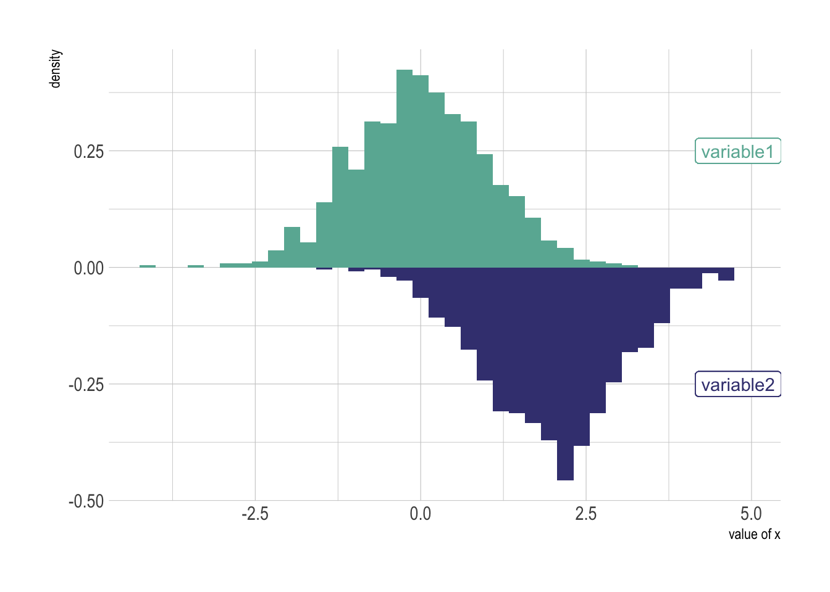
Variation
A common variation of the histogram is the mirror histogram: it puts face to face 2 histograms to compare their distribution.

Slide 41
Common mistakes
Try several bin size, it can lead to very different conclusions.
Don’t use weird color scheme. It does not give any more insight.
Don’t confound it with a barplot. A barplot gives a value for each group of a categorical variable. Here, we have only a numeric variable and we check its distribution.
Don’t compare more than 3 groups in the same histogram. The graphic gets cluttered and hardly understandable. Instead use a violin plot, a boxplot, a ridgeline plot or use small multiple.
Using unequal bin widths.

Slide 42
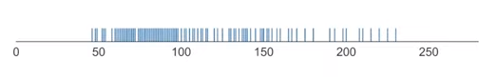
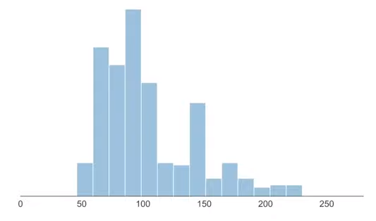
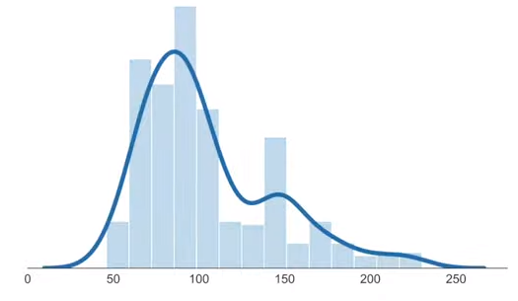

Slide 43
What is a Kernel?
A kernel is a special type of probability density function (PDF) with the added property that it must be even. Thus, a kernel is a function with the following properties
non-negative
real-valued
even
its definite integral over its support set must equal to 1

Slide 44
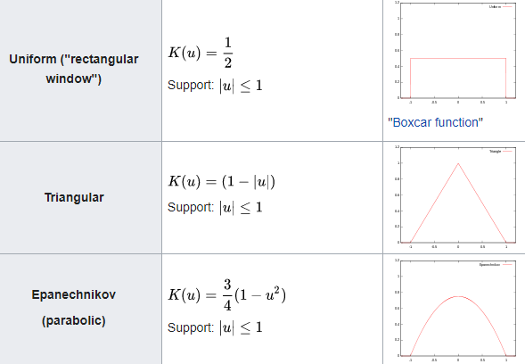
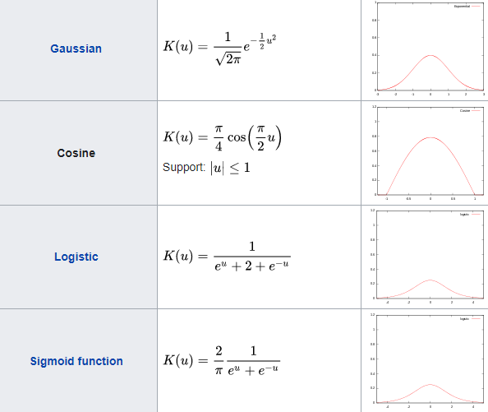
Kernel Functions

Slide 45
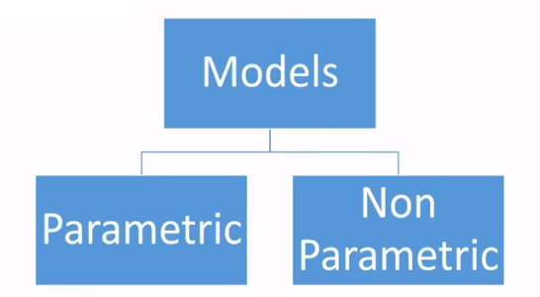
Statistical Estimation

Slide 46
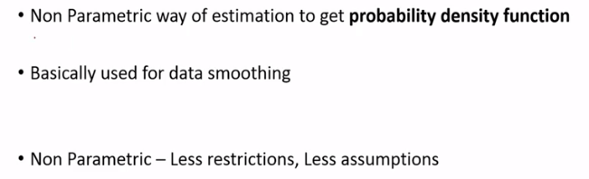
Kernel Density Estimation

Slide 47
What is Kernel Density Estimation?
Kernel density estimation is a non-parametric method of estimating the probability density function (PDF) of a continuous random variable. It is non-parametric because it does not assume any underlying distribution for the variable. Essentially, at every datum, a kernel function is created with the datum at its centre – this ensures that the kernel is symmetric about the datum. The PDF is then estimated by adding all of these kernel functions and dividing by the number of data to ensure that it satisfies the 2 properties of a PDF:
Every possible value of the PDF (i.e. the function, ), is non-negative.
The definite integral of the PDF over its support set equals to 1.

Slide 48
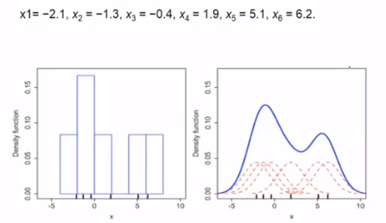
KDE and Histogram

Slide 49
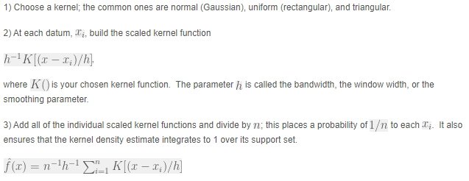

Constructing a Kernel Density Estimate

Slide 50
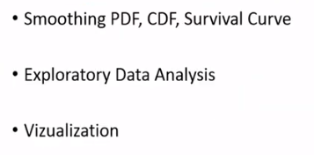
Use

Slide 51
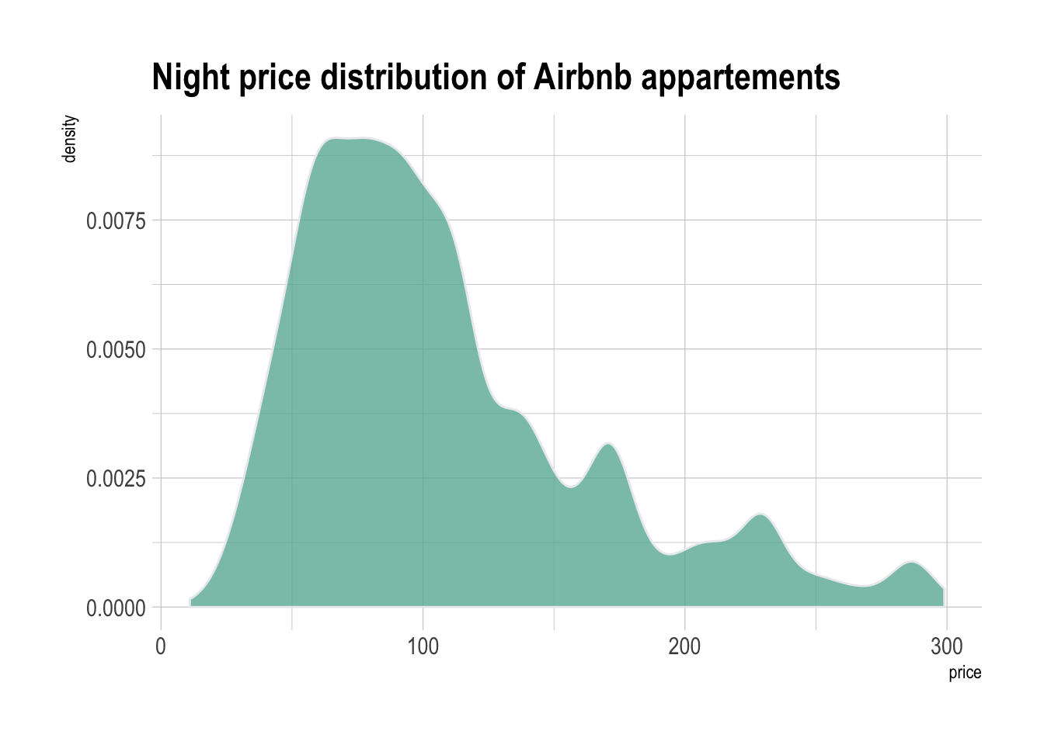
Density
A density plot is a representation of the distribution of a numeric variable. It uses a kernel density estimate to show the probability density function of the variable.
It is a smoothed version of the histogram and is used in the same concept.

Slide 52
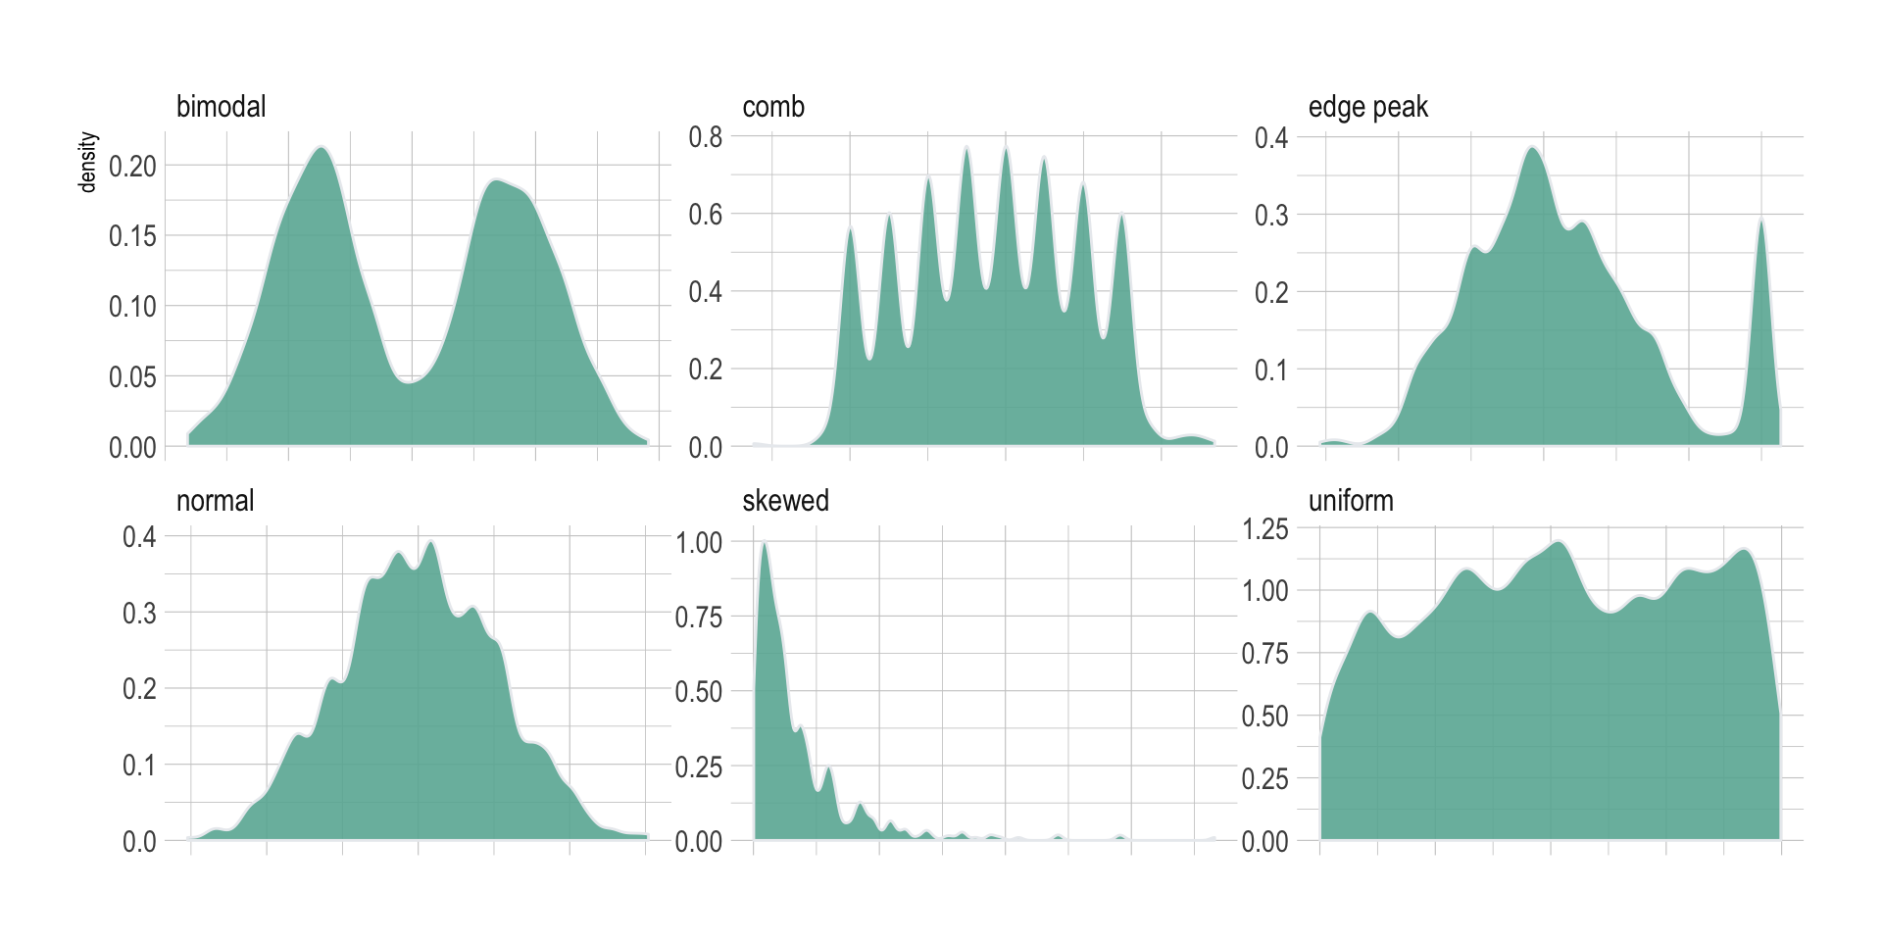
What for
Density plots are used to study the distribution of one or a few variables. Checking the distribution of your variables one by one is probably the first task you should do when you get a new dataset. It delivers a good quantity of information. Several distribution shapes exist, here is an illustration of the 6 most common ones:

Slide 53
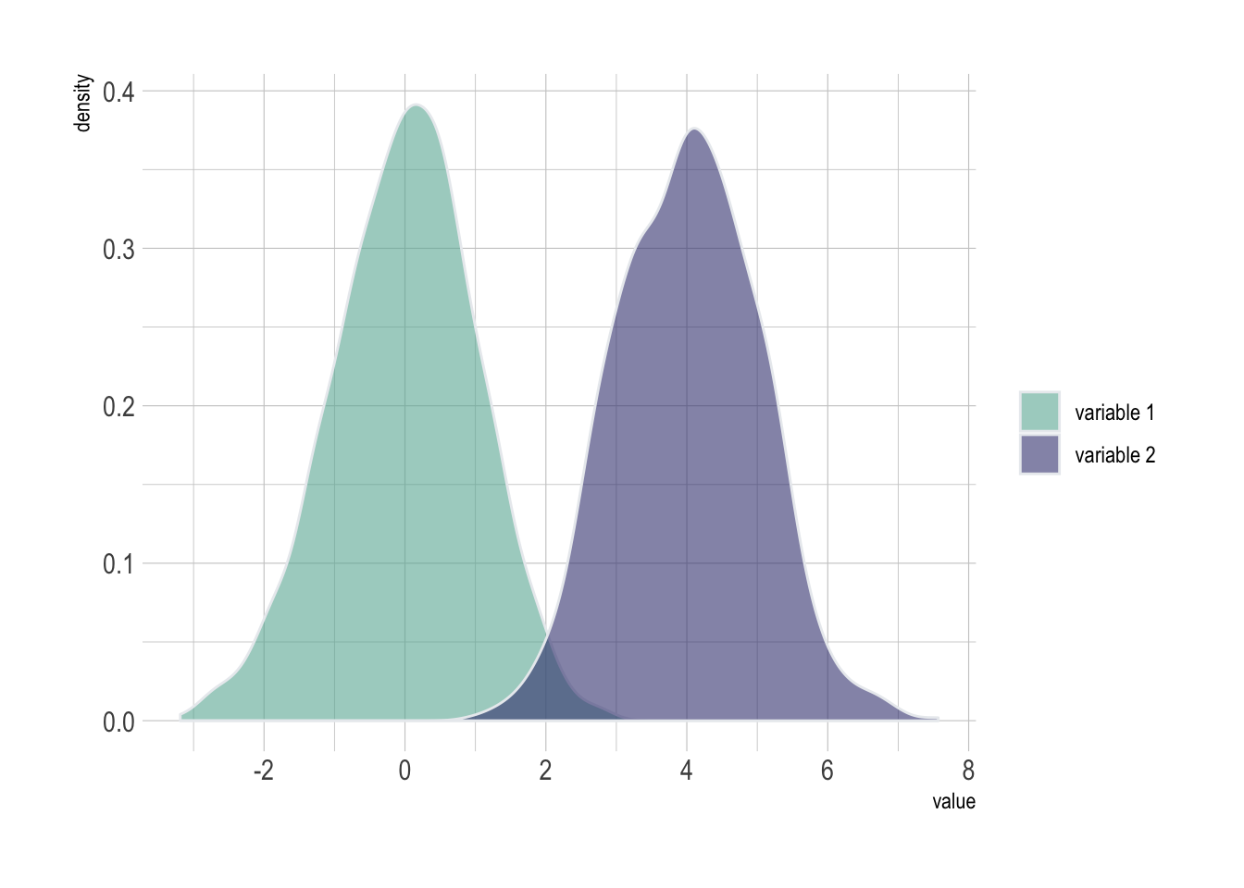
Cont’d…
As a second step, histogram allow to compare the distribution of a few variables. Don’t compare more than 3 or 4, it would make the figure cluttered and unreadable. This comparison can be done showing the 2 variables on the same graphic and using transparency.

Slide 54
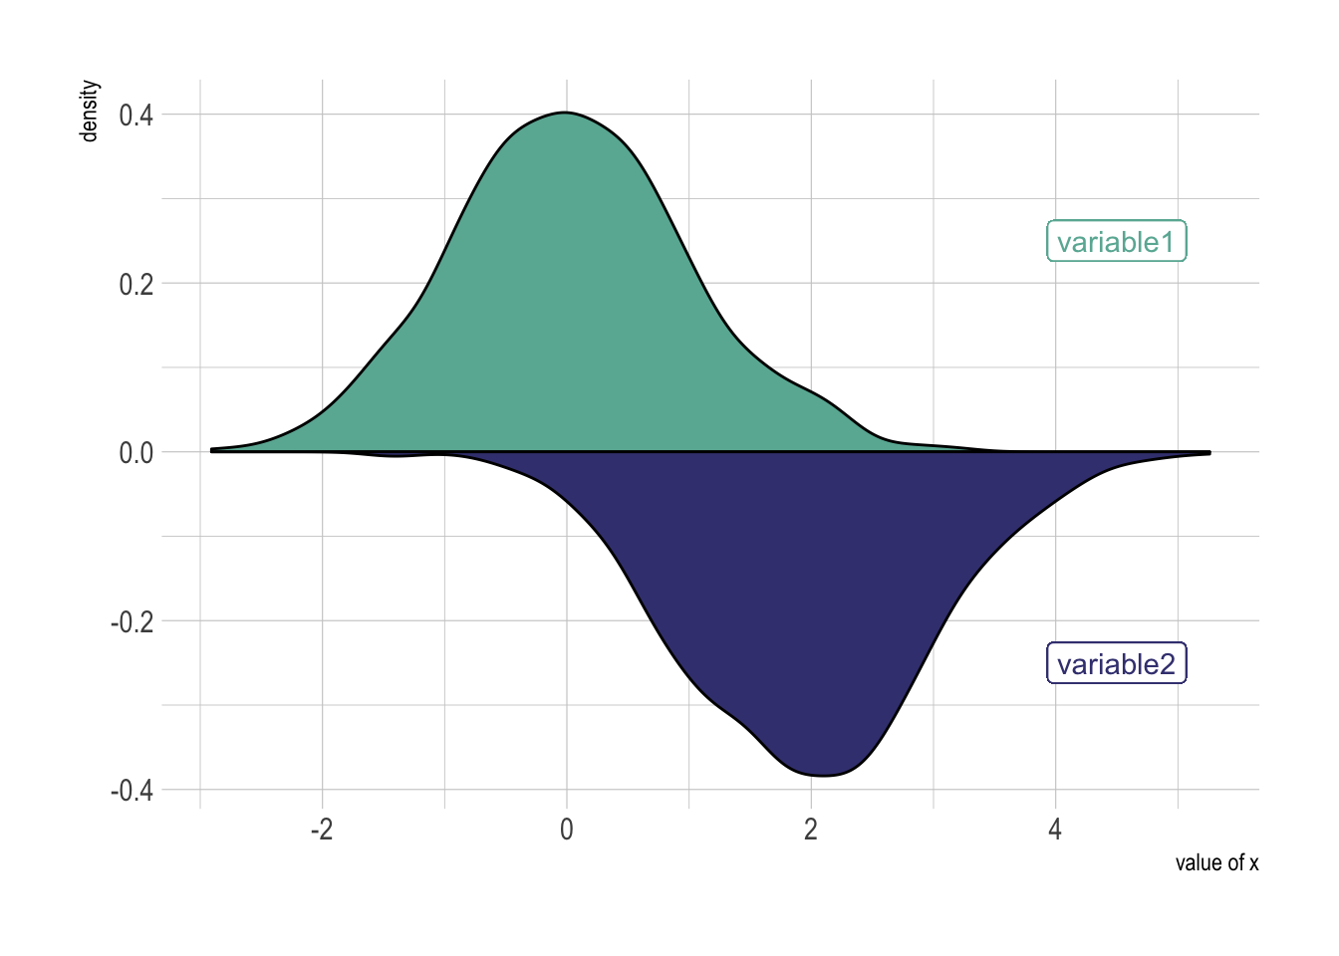
Variation
A common variation of the histogram is the mirror histogram: it puts face to face 2 histograms to compare their distribution.

Slide 55
Common mistakes
Play with the bandwidth argument, it can lead to very different conclusions.
Don’t compare more than 3 groups on the same density plot. The graphic gets cluttered and hardly understandable. Instead use a violin plot, a boxplot, a ridgeline plot or use small multiple.

Slide 56
Ridgeline Plot
A Ridgeline plot (sometimes called Joyplot) shows the distribution of a numeric value for several groups. Distribution can be represented using histograms or density plots, all aligned to the same horizontal scale and presented with a slight overlap.

Slide 57
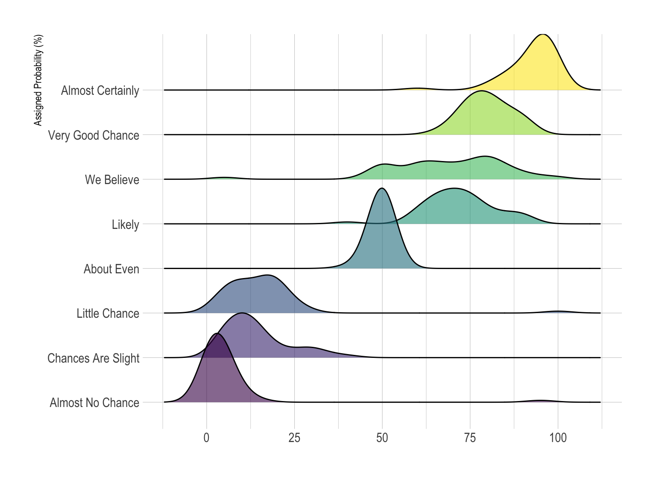
Example
What probability would you assign to the phrase “Highly likely” were asked. Answers between 0 and 100 were recorded, and here is the distribution for each question:

Slide 58
What for
Ridgeline plots make sense when the number of group to represent is medium to high, and thus a classic window separation would take to much space. Indeed, the fact that groups overlap each other allows to use space more efficiently. If you have less than 6 groups, dealing with other distribution plots is probably better.
It works well when there is a clear pattern in the result, like if there is an obvious ranking in groups. Otherwise group will tend to overlap each other, leading to a messy plot not providing any insight.

Slide 59
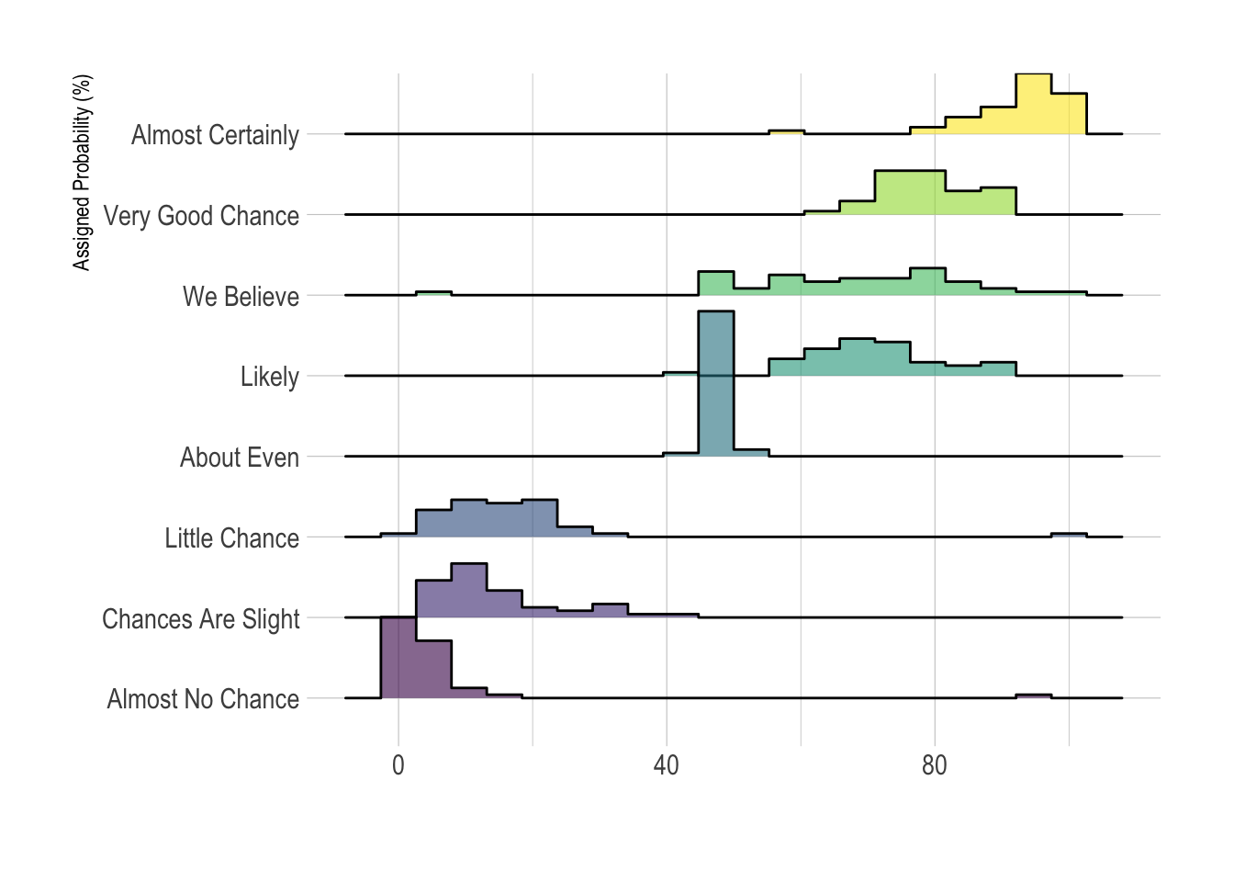
Variation
The above example is a ridgeline plot using a set of density plots. It is possible to use histograms as well:

Slide 60
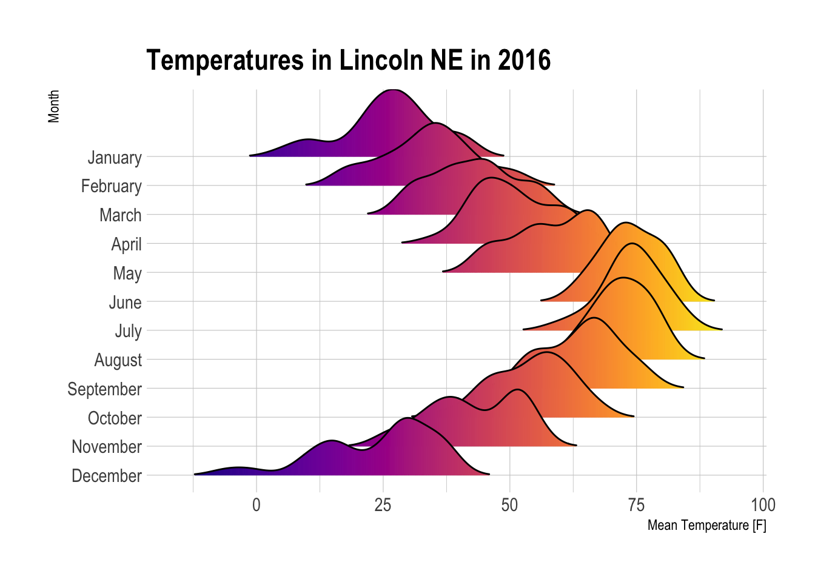
Cont’d…
It is possible to color depending on the numeric variable instead of the categoric one.

Slide 61
Common mistakes
As with histogram or density plot, play with bin size / bandwidth argument.
Think about ordering groups in a smart way.
Ridgeline plot works well when there is a clear pattern to discover since it hides a part of the data where the overlap takes place.

Slide 62
Boxplot
A boxplot gives a nice summary of one or more numeric variables. A boxplot is composed of several elements:
The line that divides the box into 2 parts represents the median of the data. If the median is 10, it means that there are the same number of data points below and above 10.
The ends of the box shows the upper (Q3) and lower (Q1) quartiles. If the third quartile is 15, it means that 75% of the observation are lower than 15.
The difference between Quartiles 1 and 3 is called the interquartile range (IQR).
The extreme line shows Q3+1.5x(IQR) to Q1-1.5x(IQR) (the highest and lowest value excluding outliers).
Dots (or other markers) beyond the extreme line shows potential outliers.

Slide 63
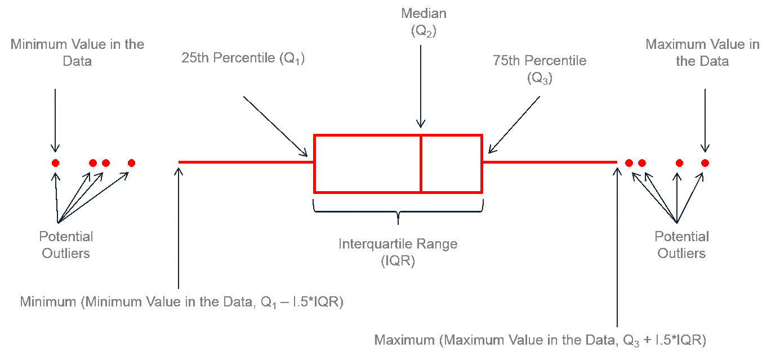
Boxplot Anatomy

Slide 64
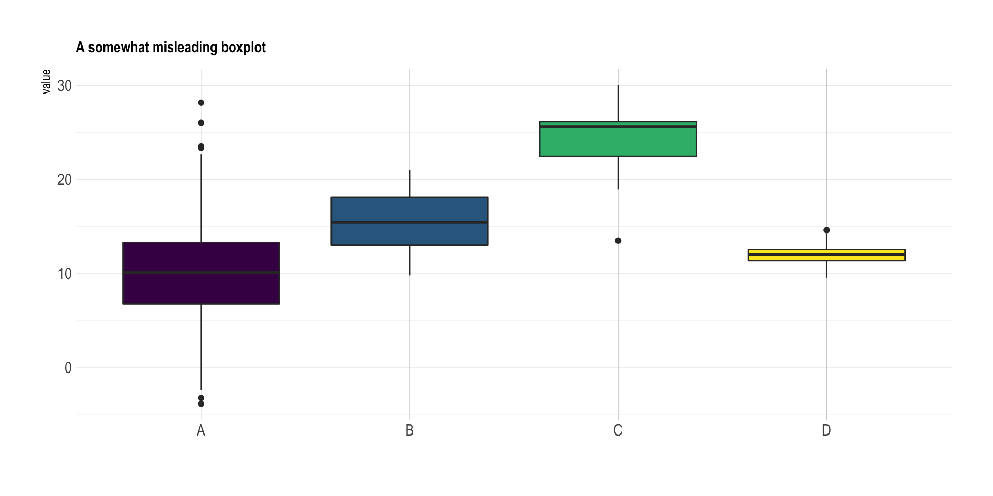
Cont’d…
A boxplot can summarize the distribution of a numeric variable for several groups. The problem is that summarizing also means losing information, and that can be a pitfall. If we consider the boxplot below, it is easy to conclude that group C has a higher value than the others. However, we cannot see the underlying distribution of dots in each group or their number of observations.

Slide 65
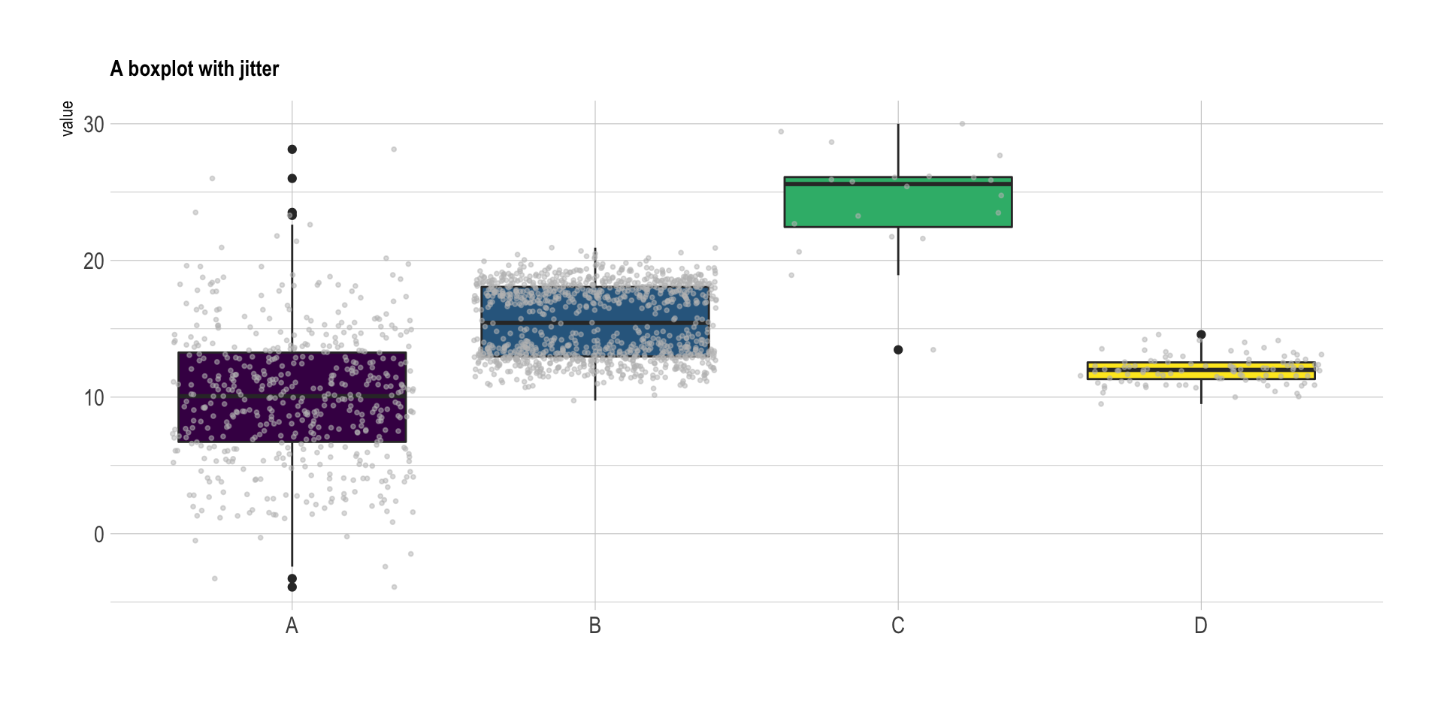
Adding jitter
If the amount of data you are working with is not too large, adding jitter on top of your boxplot can make the graphic more insightful.
Here some new patterns appear clearly. Group C has a small sample size compared to the other groups. This is definitely something you want to find out before saying that group C has a higher value than the others. Moreover, it looks like group B has a bimodal distribution: dots are distributed in 2 groups: around y=18 and y=13.

Slide 66
Violin Plot
Violin plot allows to visualize the distribution of a numeric variable for one or several groups. Each ‘violin’ represents a group or a variable. The shape represents the density estimate of the variable: the more data points in a specific range, the larger the violin is for that range. It is really close to a boxplot, but allows a deeper understanding of the distribution.

Slide 67
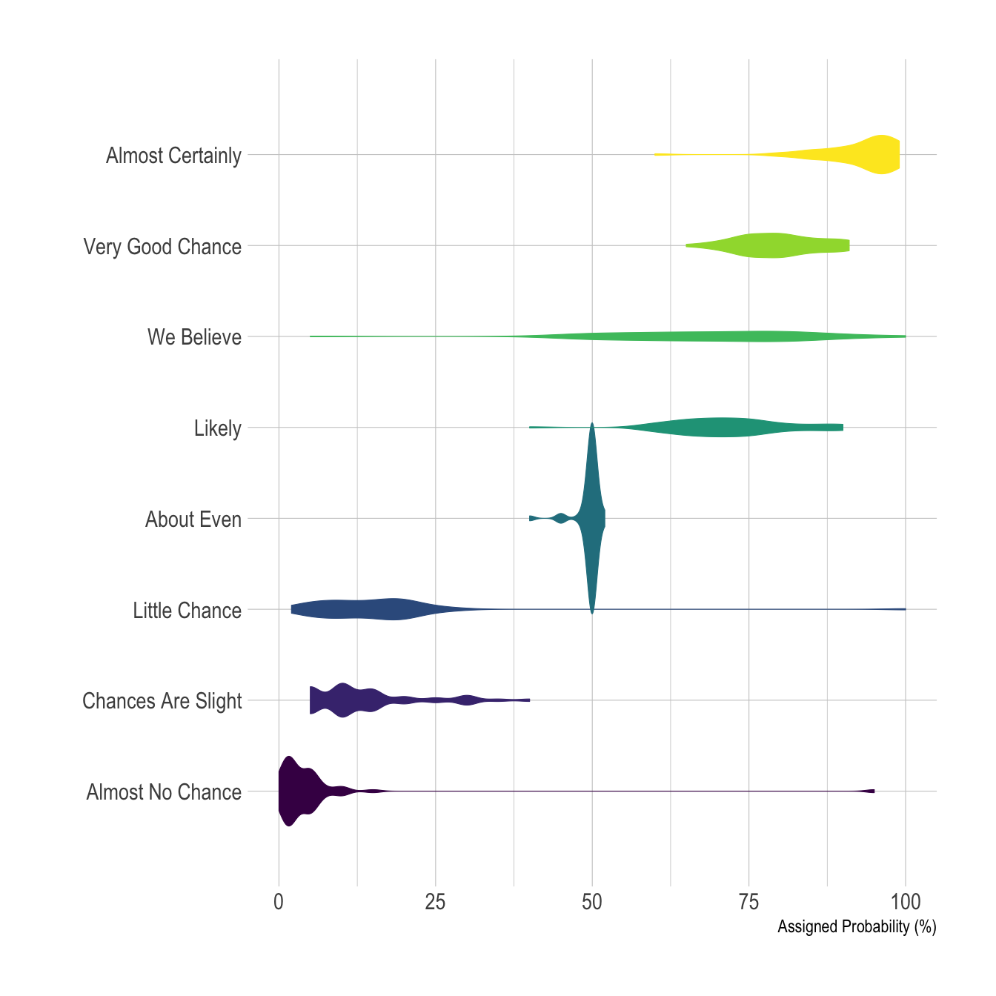
Example
What probability would you assign to the phrase “Highly likely” were asked. Answers between 0 and 100 were recorded, and here is the distribution for each question:

Slide 68
What for
Violin plot is a powerful data visualization technique since it allows to compare both the ranking of several groups and their distribution. Surprisingly, it is less used than boxplot, even if it provides more information in my opinion.
Violins are particularly adapted when the amount of data is huge and showing individual observations gets impossible. For small datasets, a boxplot with jitter is probably a better option since it really shows all the information.

Slide 69
Variation
Violin plot are made vertically most of the time. If you have long labels, building a horizontal version like above make the labels more readable.
It is possible to display a boxplot in the violin. It allows to assess the median and quartiles in a glimpse.

Slide 70
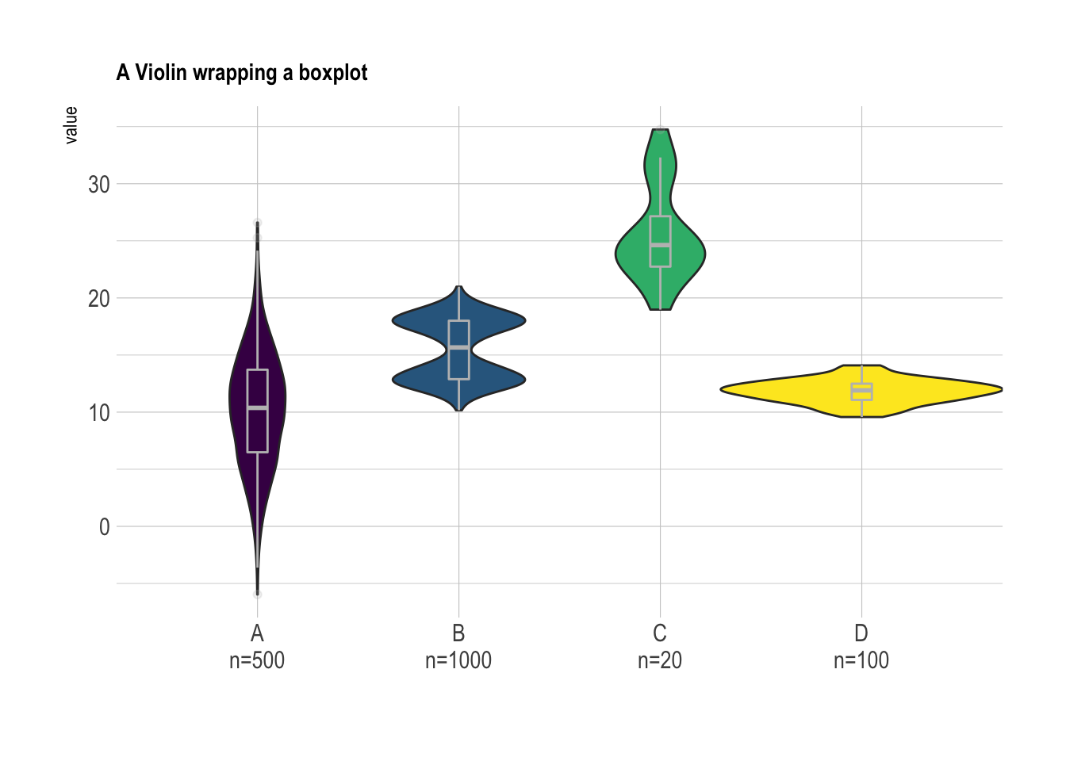
Cont’d…
Here it is very clear that the groups have different distributions. The bimodal distribution of group B becomes obvious. Violin plots are a powerful way to display information–they are probably under-utilized compared to boxplots.

Slide 71
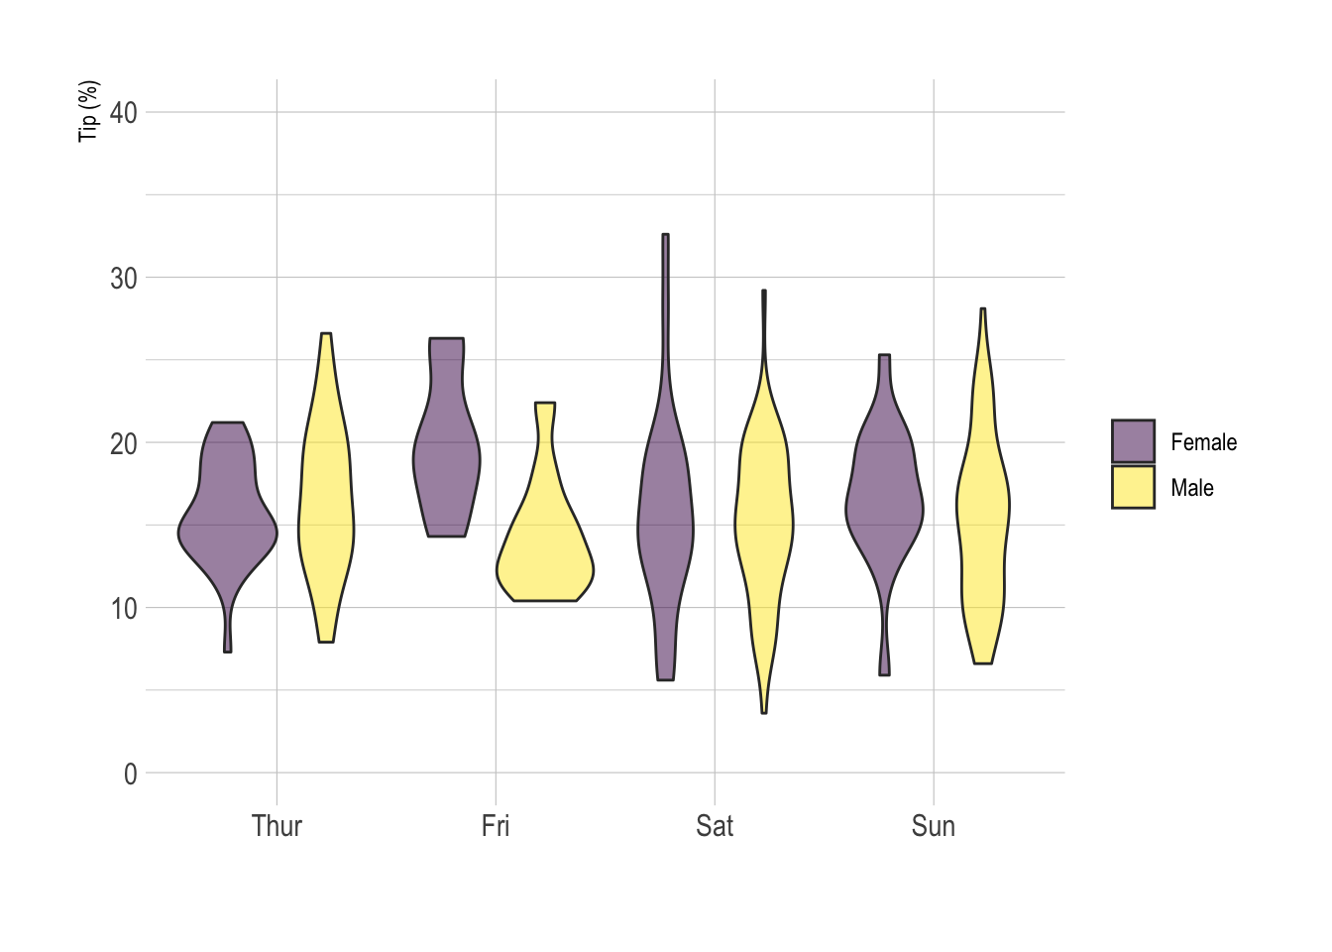
Cont’d…
If your variable are grouped, you can build a grouped violin as you would do for a boxplot. Here is an example showing how much Male and Female tip depending on the day of the week.

Slide 72
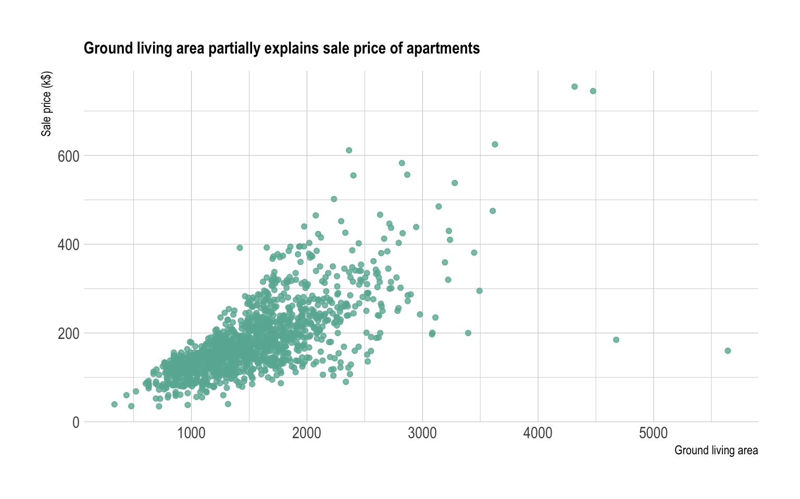
Scatter Plot
A scatterplot displays the relationship between 2 numeric variables. For each data point, the value of its first variable is represented on the X axis, the second on the Y axis.
Here is an example considering the price of 1460 apartments and their ground living area.

Slide 73
What for
A scatterplot is made to study the relationship between 2 variables. Thus it is often accompanied by a correlation coefficient calculation, that usually tries to measure the linear relationship.
However other types of relationship can be detected using scatterplots, and a common task consists to fit a model explaining Y in function of X. Here is a few pattern you can detect doing a scatterplot.

Slide 74

Cont’d…

Slide 75

Cont’d…
Scatterplot are sometimes supported by marginal distributions. It indeed adds insight to the graphic, revealing the distribution of both variables:

Slide 76
Heat Map
A heatmap is a graphical representation of data where the individual values contained in a matrix are represented as colors. It is a bit like looking a data table.
Here is an example showing 8 general features like population or life expectancy for about 30 countries in 2015.

Slide 77

Example
Heatmap is really useful to display a general view of numerical data, not to extract specific data point.

Slide 78
Variation
A common task is to compare the result with expectations. For instance, we can check if the countries are clustering according to their continent using a color bar.
For static heatmap, a common practice is to display the exact value of each cell in numbers. Indeed, it is hard to translate a color in a precise number.
Heatmaps can also be used for time series where there is a regular pattern in time.
Heatmaps can be applied to adjacency matrix.

Slide 79
Common mistakes
Often need to normalize your data.
Use cluster analysis and thus permute the rows and the columns of the matrix to place similar values near each other according to the clustering.
Color palette is important.

Slide 80

Categorical data are summarized by

Slide 81

Summary Table

Slide 82


Pareto Chart

Slide 83

Numerical data are summarized by

Slide 84

Ordered Array

Slide 85


Stem and leaf

Slide 86




Cont’d…

Slide 87

Frequency Distribution

Slide 88

Example

Slide 89

Cont’d…

Slide 90

Cumulative Frequency

Slide 91

Why do we use Frequency Distribution?

Slide 92

Some Tips

Slide 93


Histogram

Slide 94


Polygon

Slide 95

Ogive (Cumulative % Polygon)

